Slide 1
Seattle Gyms
Where to Build

Slide 2
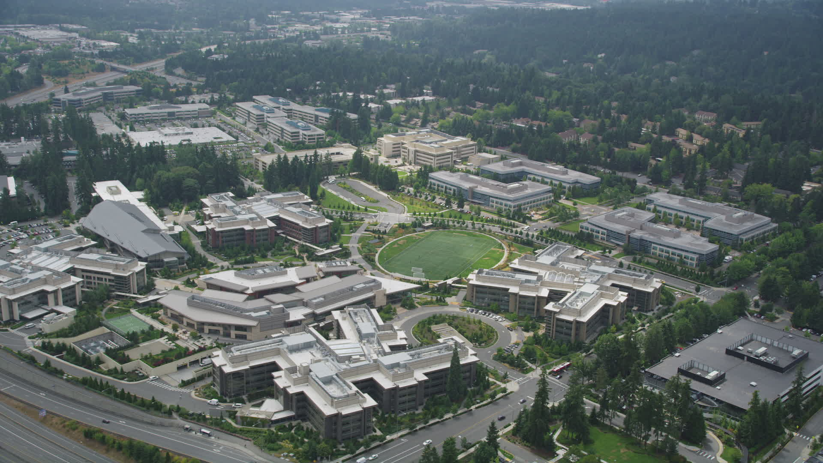
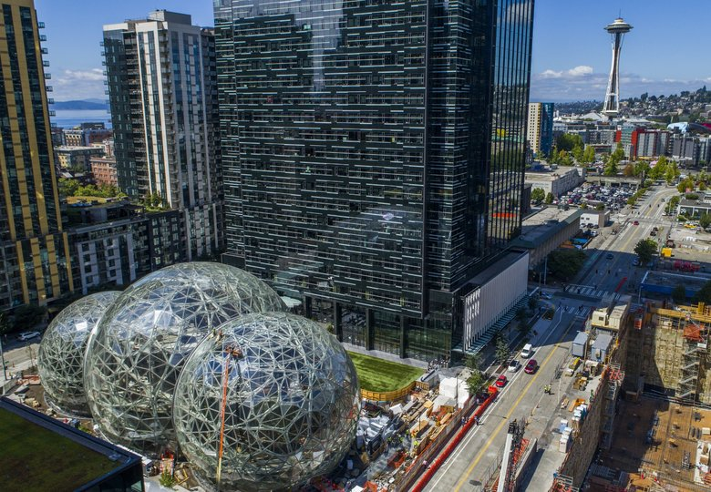
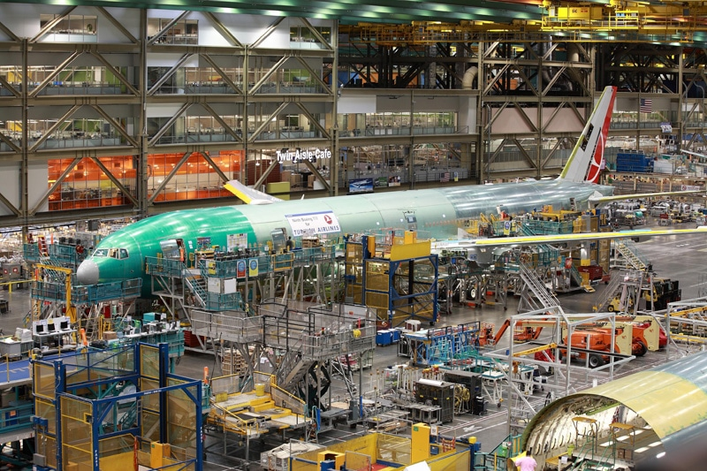
Seattle: A Strong Economy
Seattle and its surroundings are home to both old industrial powerhouses like Boeing, and such new tech powerhouses as Microsoft and Amazon.

Slide 3
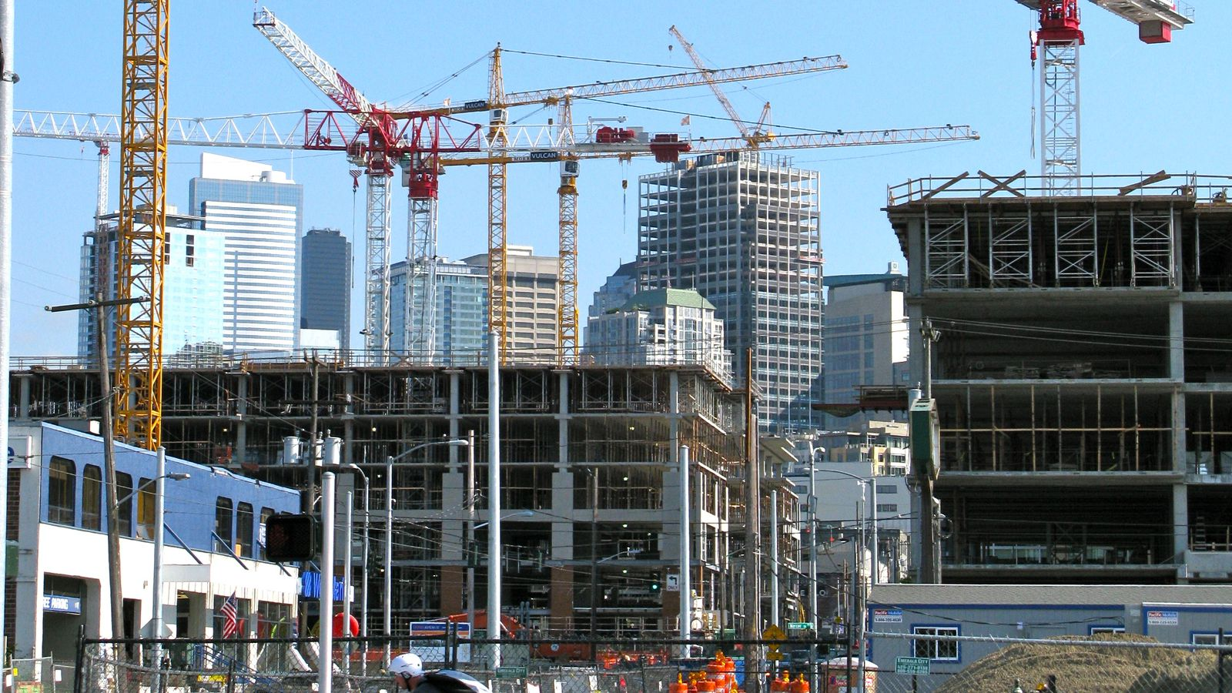
Strong Growth Projections
Over the next decade, the Seattle area’s population is expected to rise by 521,000.
Even assuming low migration, low births, and high deaths, Seattle’s population is still projected to rise by nearly 292,000
The population of those aged 20-49 alone is expected to increase by 192,000.
Explore more at http://apps.urban.org/features/mapping-americas-futures/#map

Slide 4
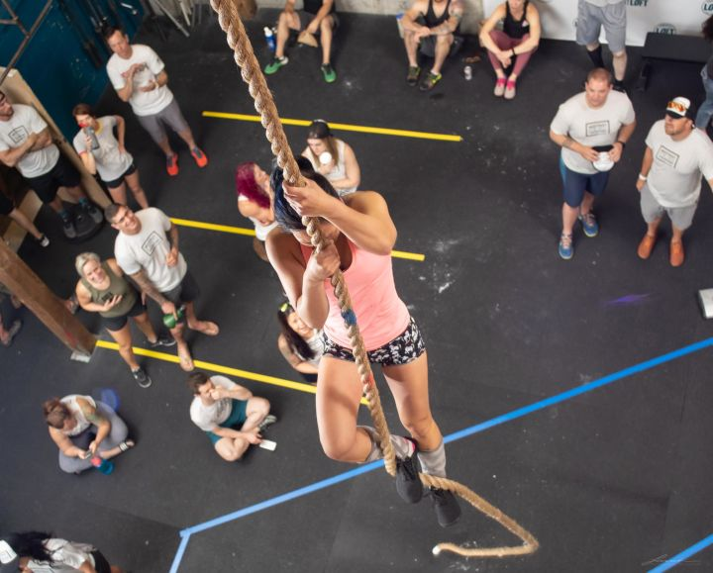
The young and growing population will need somewhere to exercise
People are more health-conscious than in the past
More people need to lose weight in the past
Jobs today require less physical activity than in the past
So…where will Seattle’s new population choose to exercise?

Slide 5
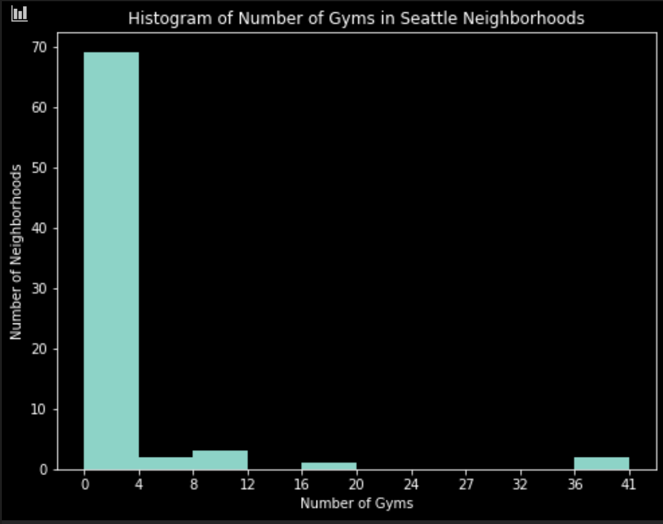
Histogram of Seattle Gyms
Most neighborhoods in Seattle do not have ANY gyms
Seattle’s gyms are concentrated in a few very competitive neighborhoods.

Slide 6
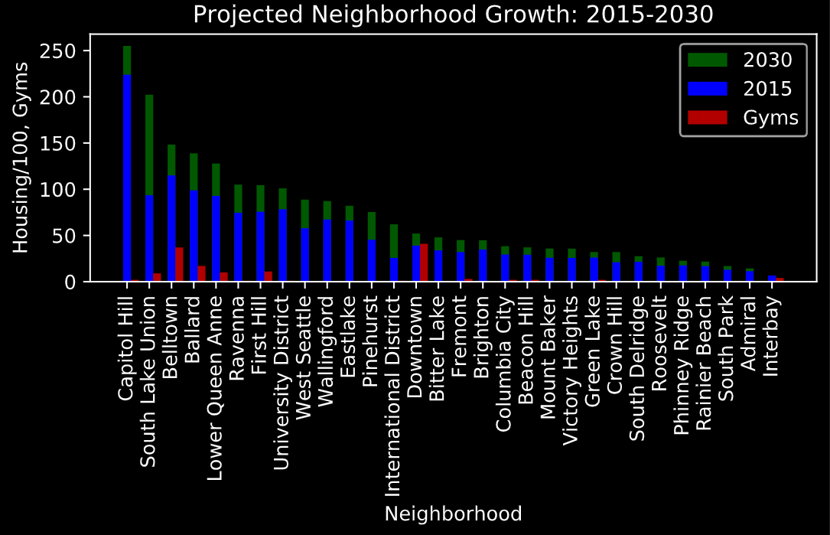
Bar graph of Seattle Housing, Growth, and Gyms by Neighborhood
Gyms are concentrated in Downtown, Belltown and Ballard.
High population Capitol Hill and high-growth South Lake Union have very few gyms.

Slide 7
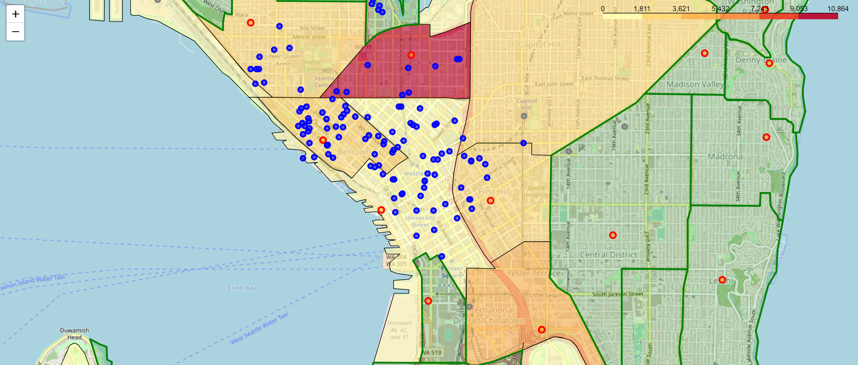
Most Gyms are in and Around Downtown

Slide 8
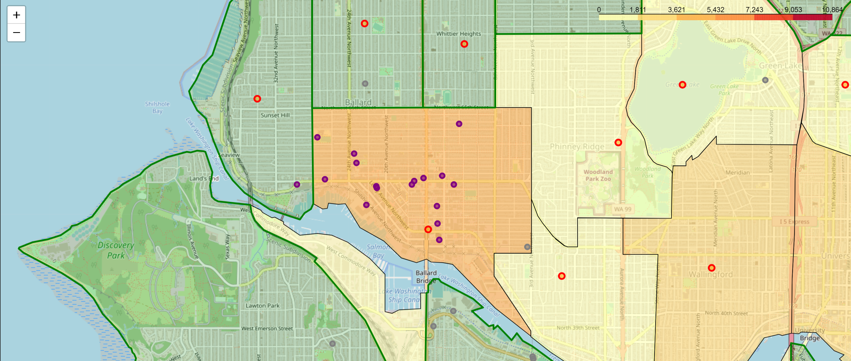
There’s another cluster of gyms in Ballard

Slide 9
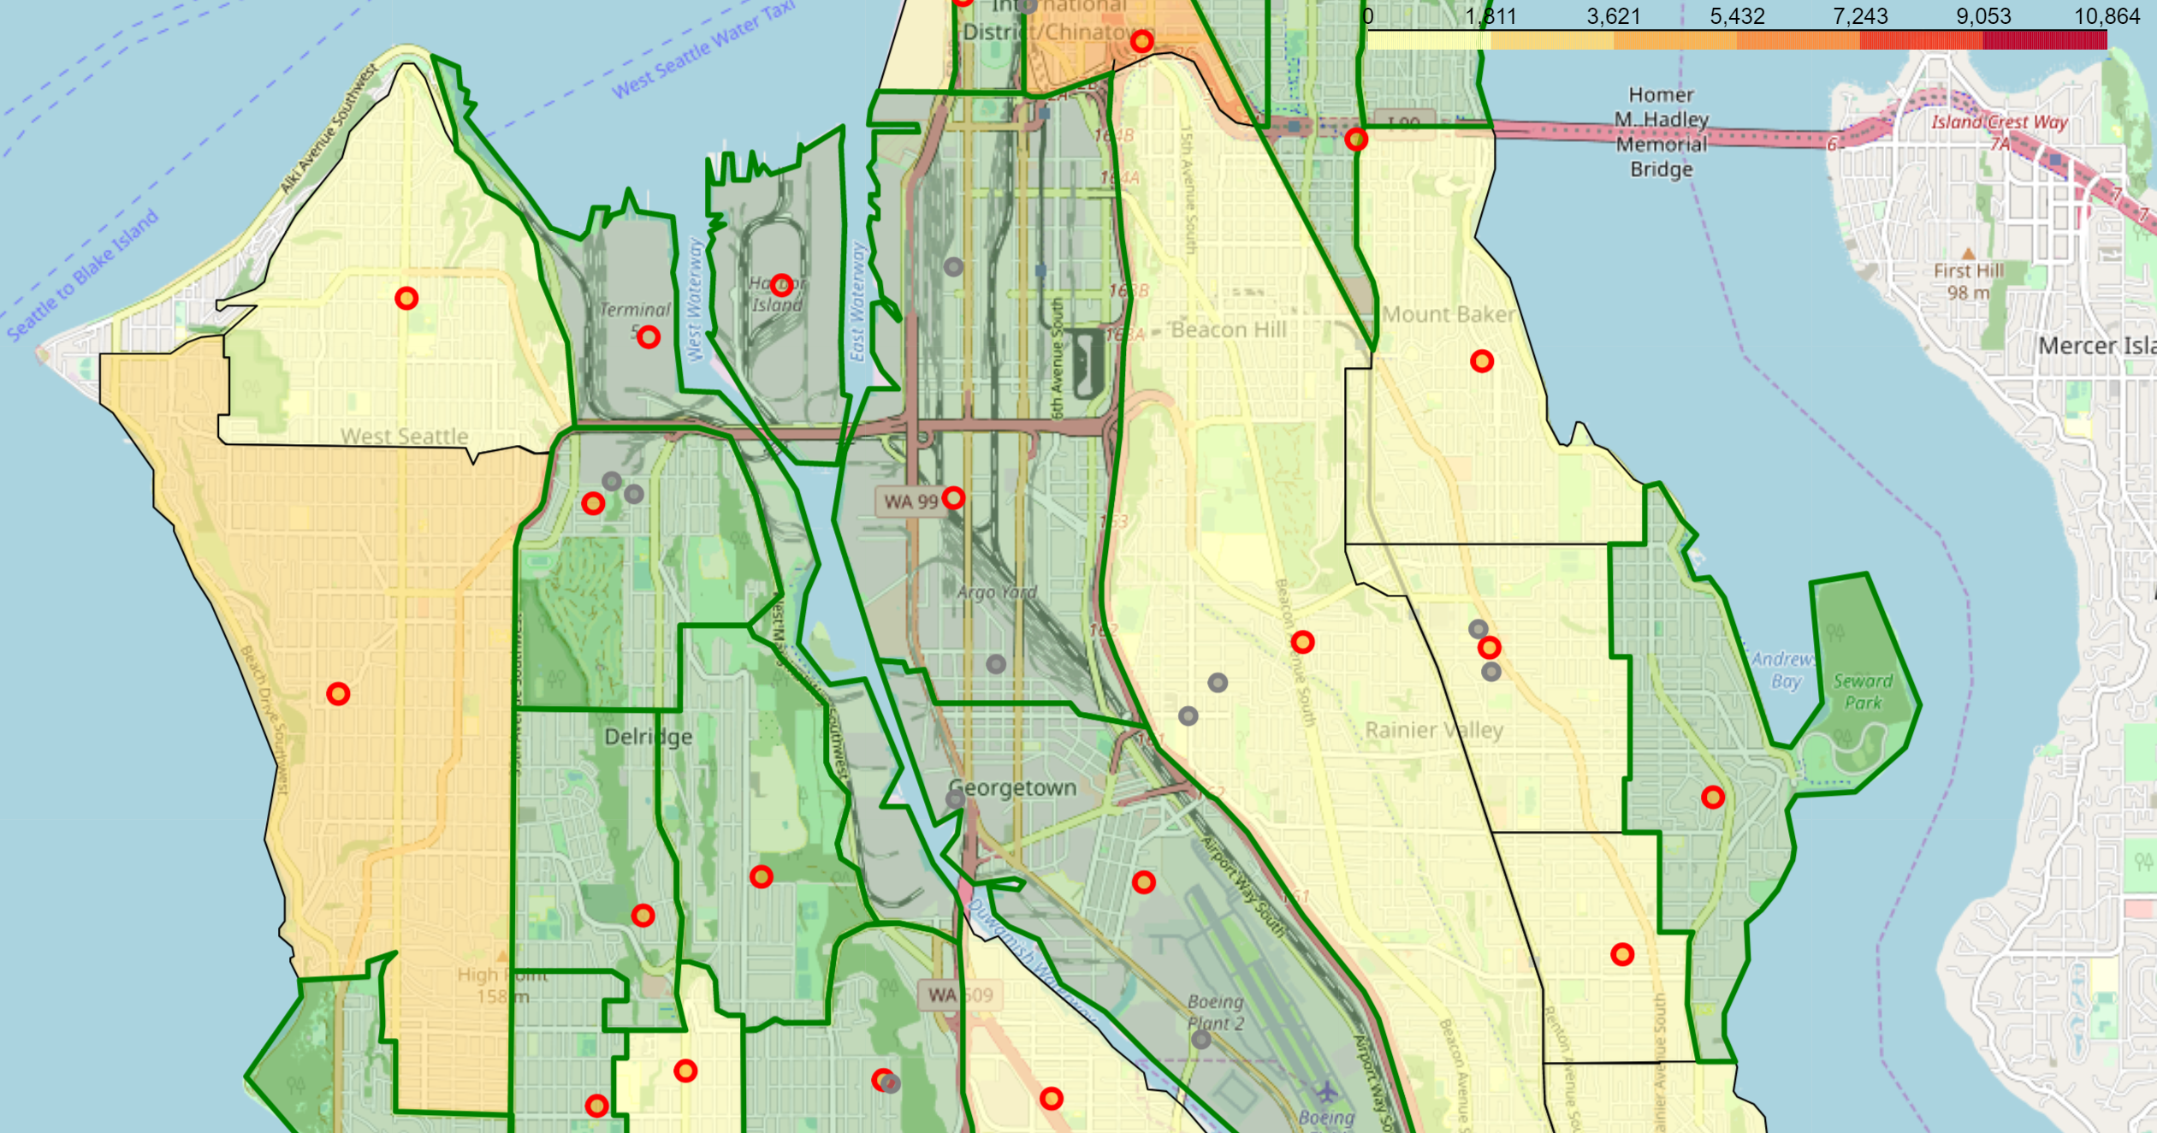
Many neighborhoods have few or no gyms

Slide 10
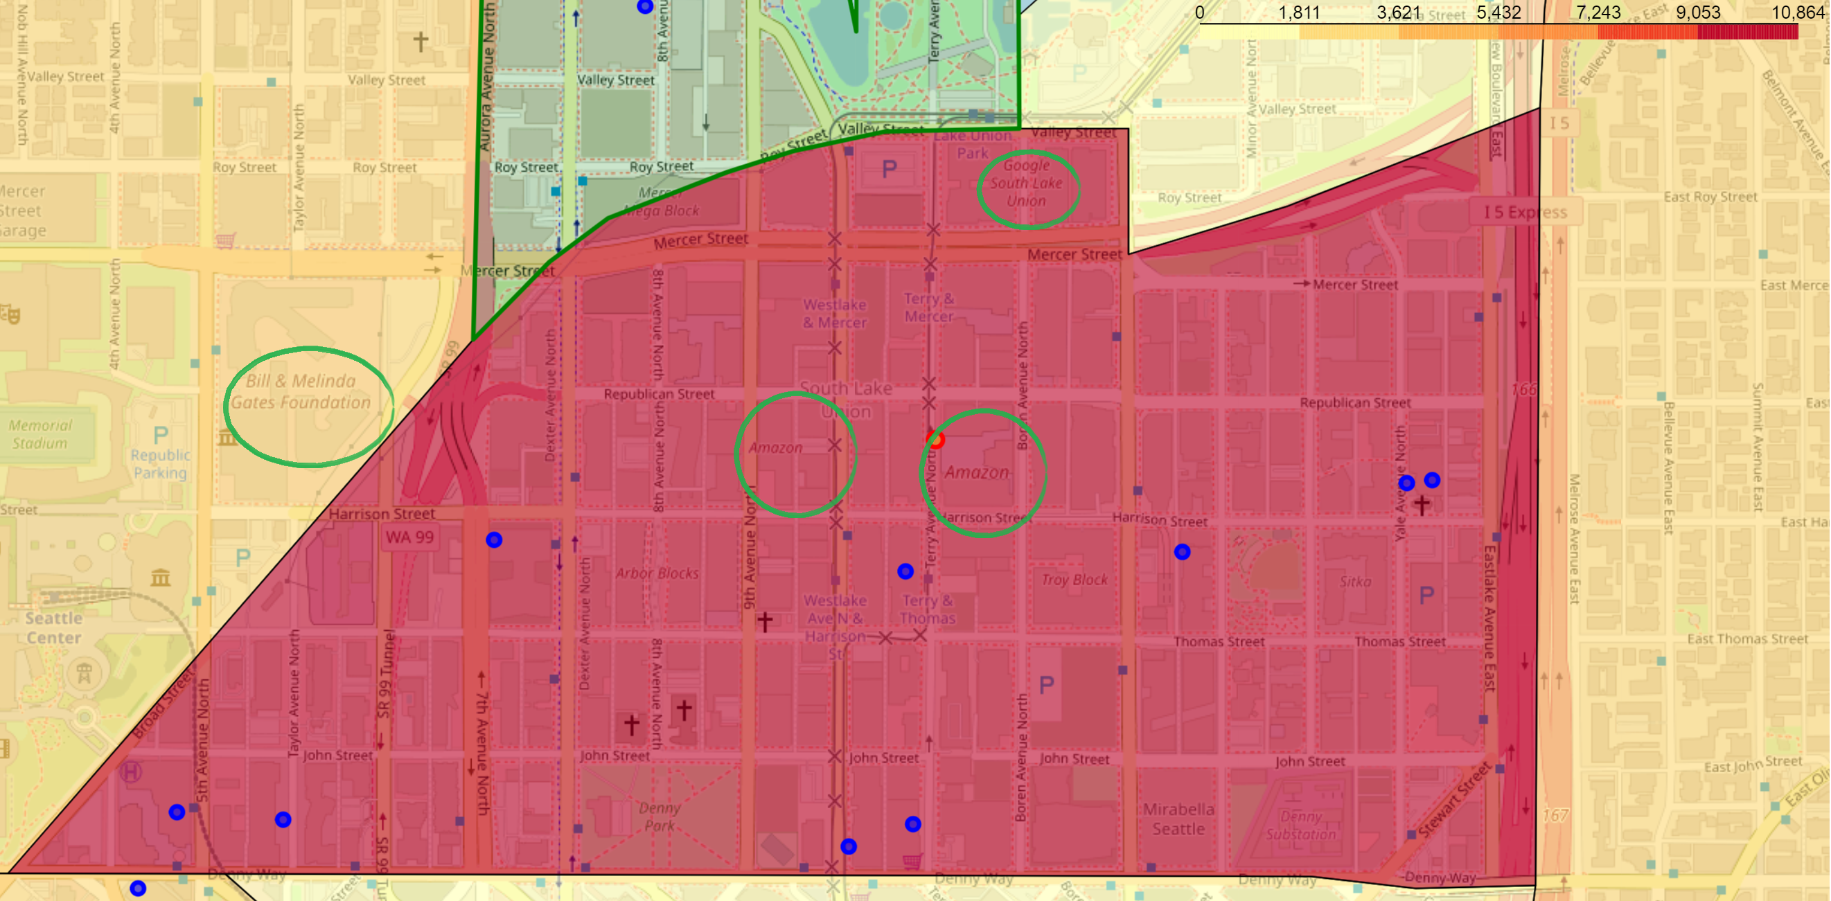
Downtown Gym Strategy
Target high-growth neighborhoods in the downtown areas.
Aim at a major business
South Lake Union is part of the downtown area and is Seattle’s fastest growing neighborhood.
South Lake Union also hosts Amazon’s headquarters, and one of Google’s offices

Slide 11
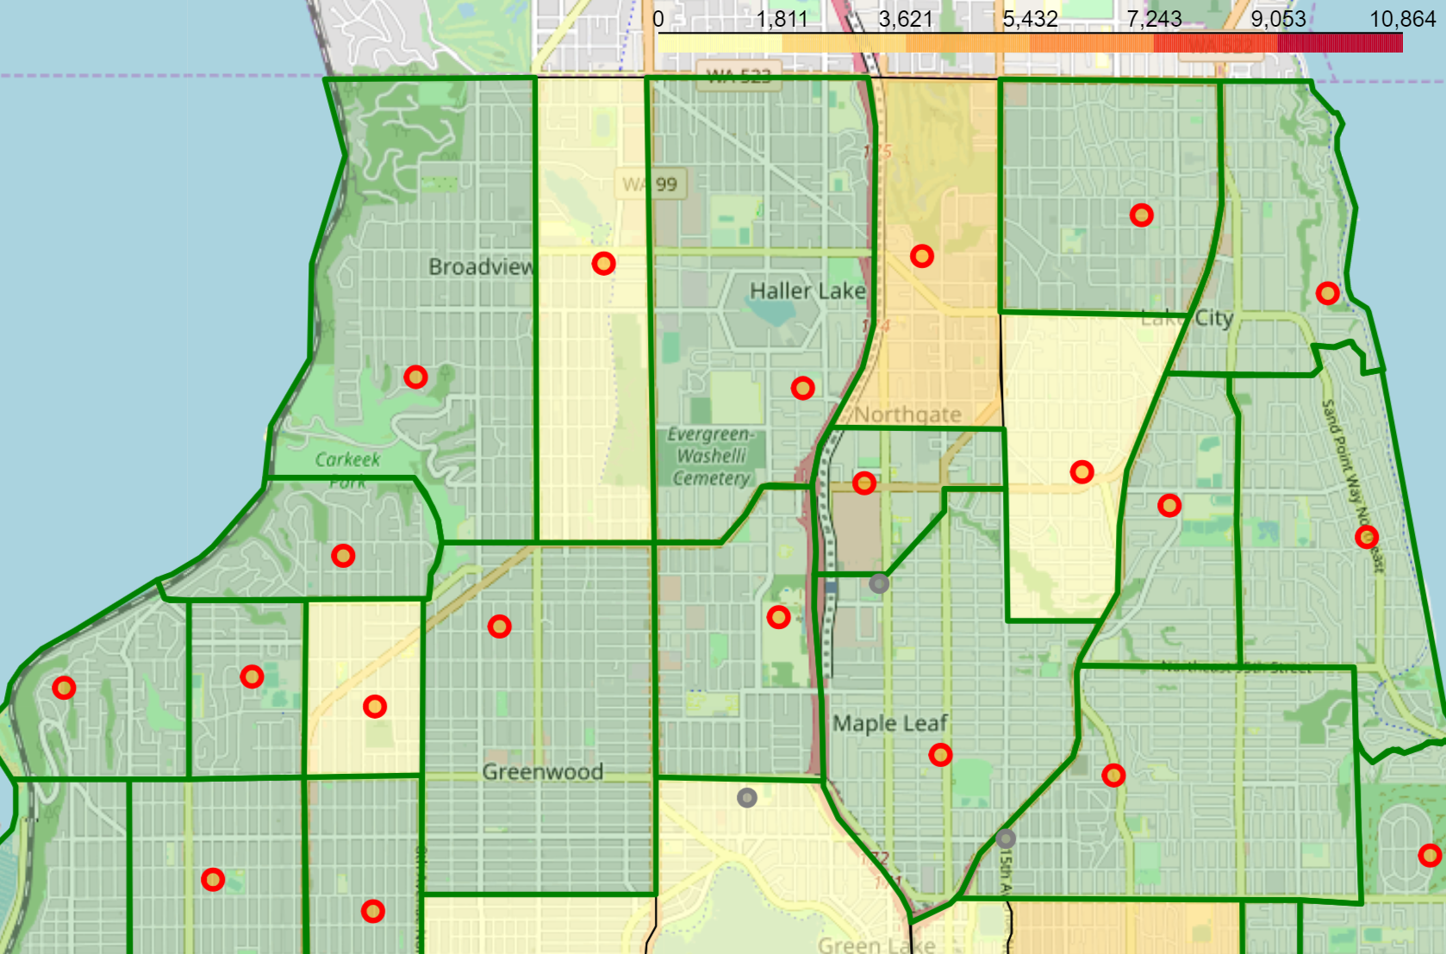
Neighborhood Gym Strategy
Some neighborhoods in Seattle, particularly on the outskirts, have few to no gyms.
Many of these are growth districts.
There is room for many neighborhood gyms that target residents rather than commuters

Slide 12
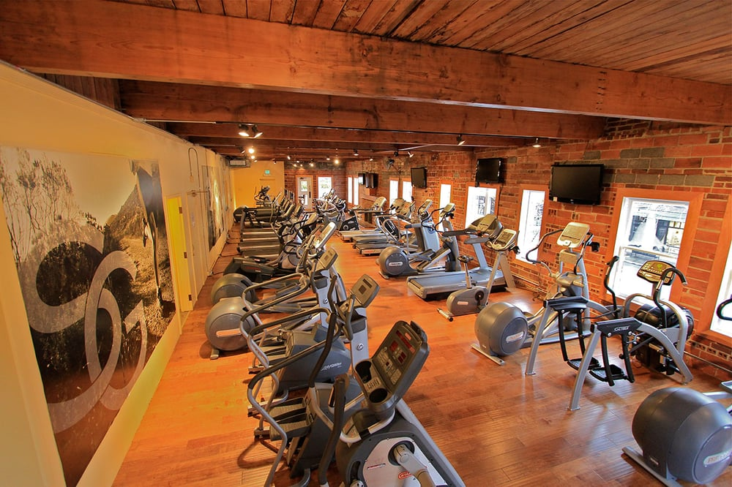
Conclusion: Grow with a Growing Seattle
Seattle is a rapidly growing city.
There are opportunities to open a successful gym both downtown, in Ballard, or in peripheral areas.
One ideal location would be in the rapidly growing South Lake Union
Or areas relatively bereft of gyms like Bitter Lake or West Seattle.

